Slide 1
Tuberculosis in Japan
Annual Report - 2017
Tuberculosis
Surveillance
Center-RIT/JATA
Japan

Slide 2
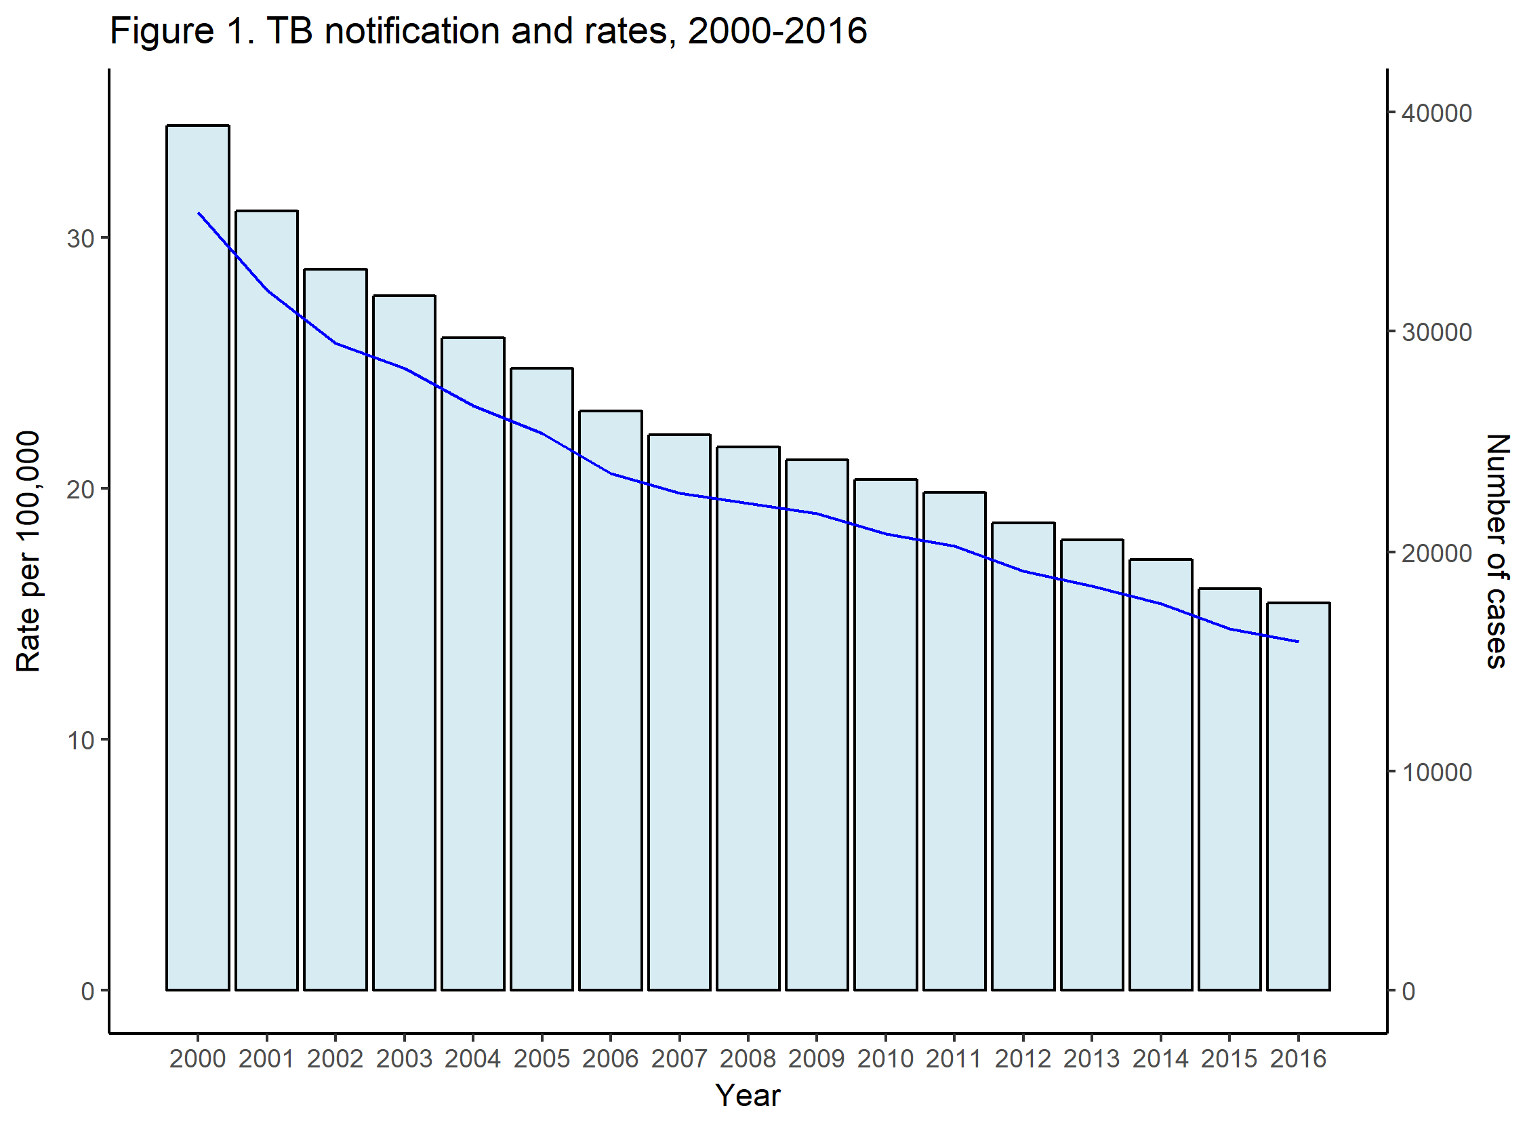
Number
Rate

Slide 3
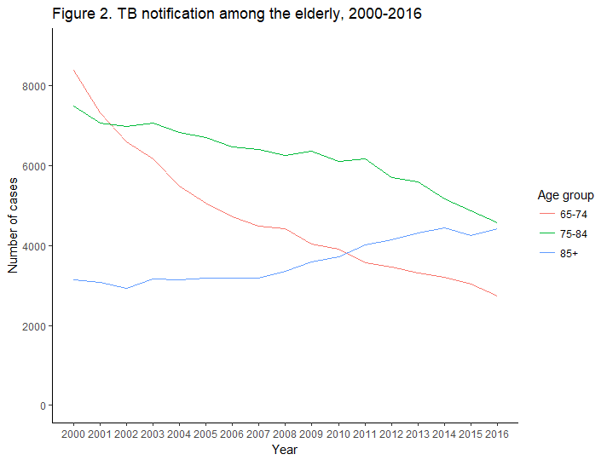

Slide 4
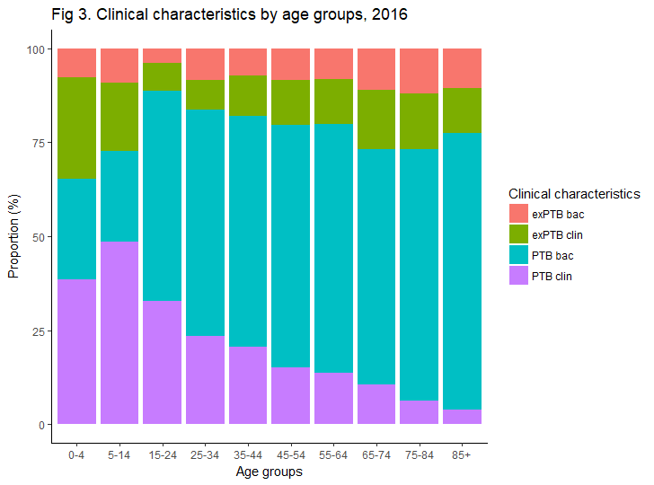

Slide 5
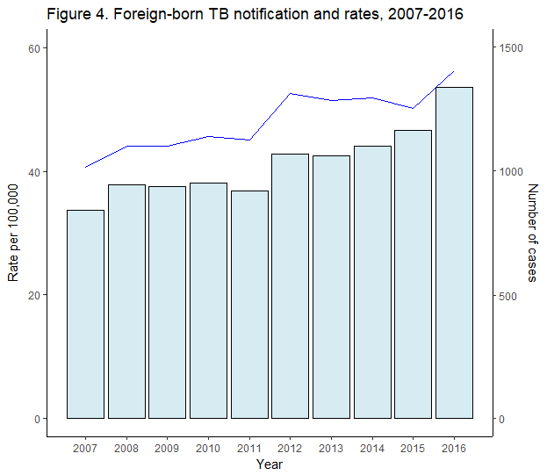
Number
Rate

Slide 6
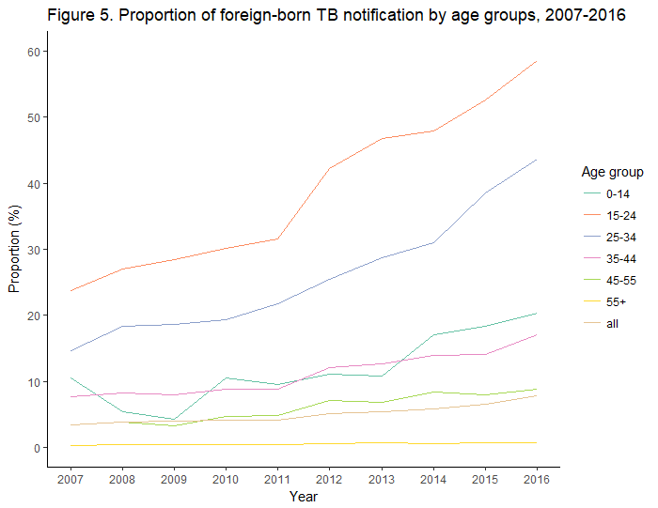

Slide 7
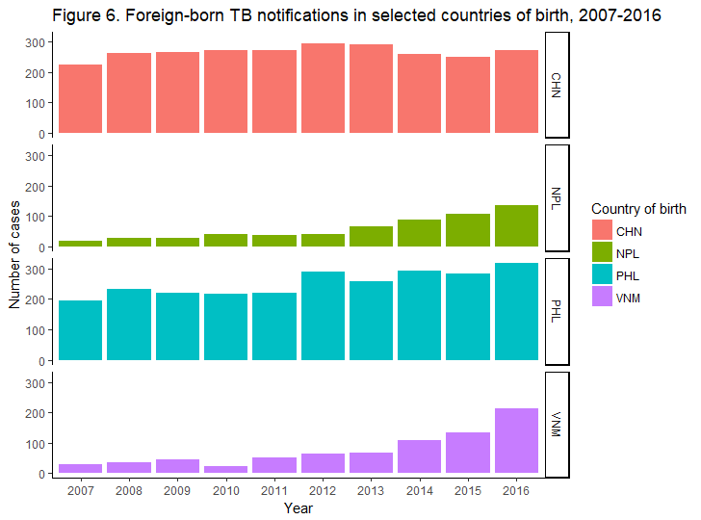

Slide 8
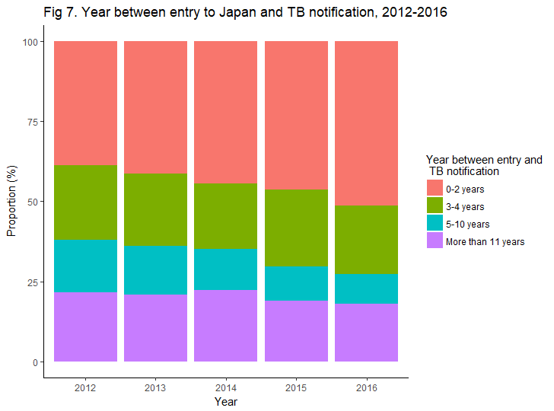

Slide 9
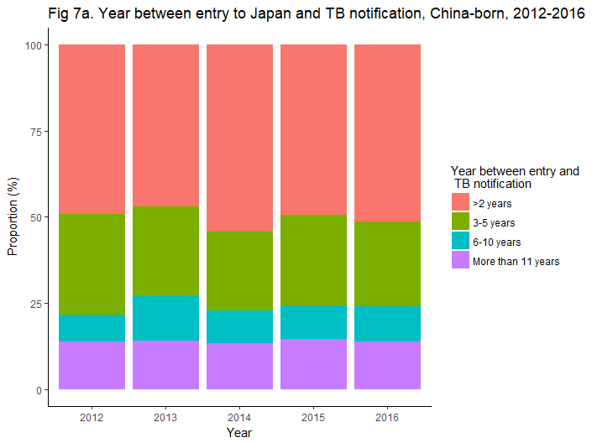
 | 2012 | 2013 | 2014 | 2015 | 2016
> 2 years | 100 | 101 | 97 | 81 | 90
3-5 years | 59 | 56 | 41 | 43 | 43
6-10 years | 16 | 28 | 17 | 16 | 18
11 + years | 28 | 30 | 24 | 24 | 24

Slide 10
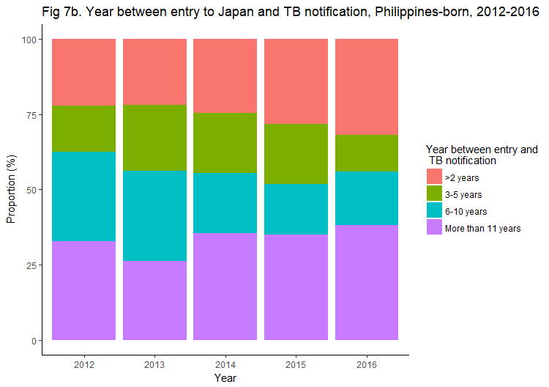
 | 2012 | 2013 | 2014 | 2015 | 2016
> 2 years | 37 | 36 | 48 | 47 | 63
3-5 years | 26 | 36 | 39 | 33 | 24
6-10 years | 50 | 49 | 39 | 28 | 35
11 + years | 55 | 43 | 69 | 58 | 75

Slide 11
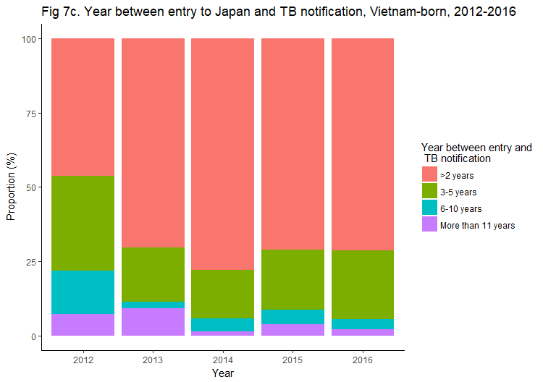
 | 2012 | 2013 | 2014 | 2015 | 2016
> 2 years | 19 | 31 | 53 | 74 | 104
3-5 years | 13 | 8 | 11 | 21 | 34
6-10 years | 6 | 1 | 3 | 5 | 5
11 + years | 3 | 4 | 1 | 4 | 3

Slide 12
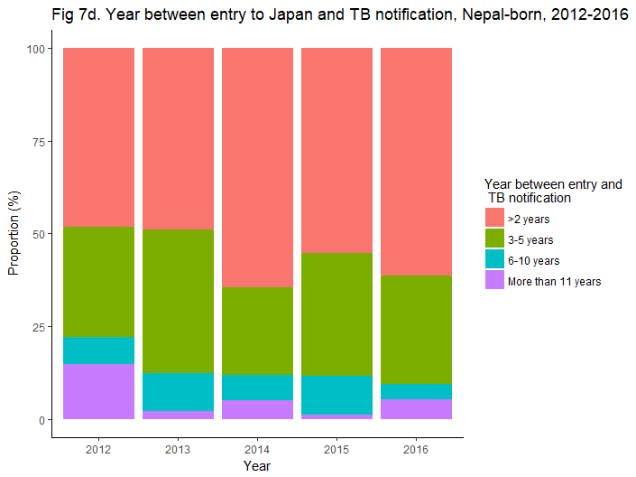
 | 2012 | 2013 | 2014 | 2015 | 2016
> 2 years | 13 | 24 | 38 | 43 | 59
3-5 years | 8 | 19 | 14 | 26 | 28
6-10 years | 2 | 5 | 4 | 8 | 4
11 + years | 4 | 1 | 3 | 1 | 5

Slide 13
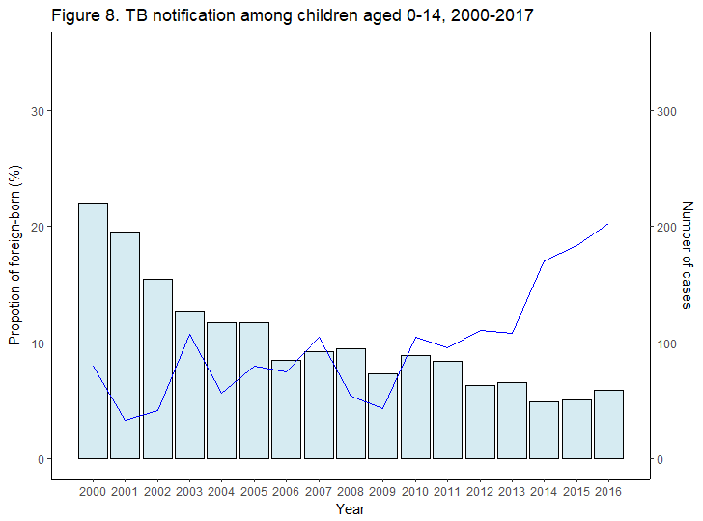
Number
Proportion

Slide 14
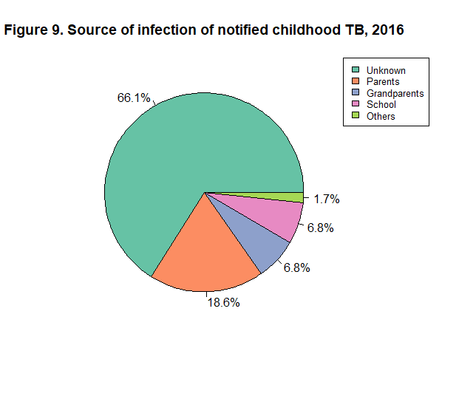

Slide 15
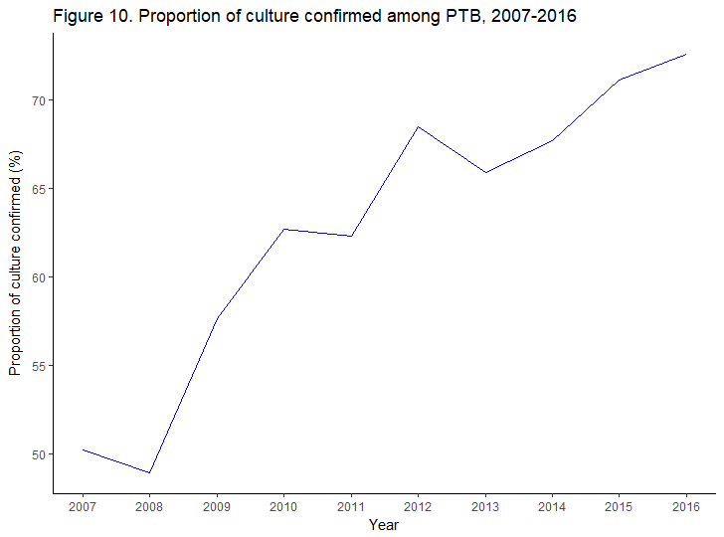

Slide 16
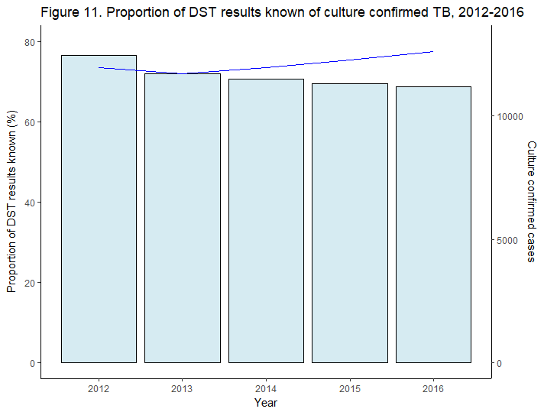
Number
Proportion

Slide 17
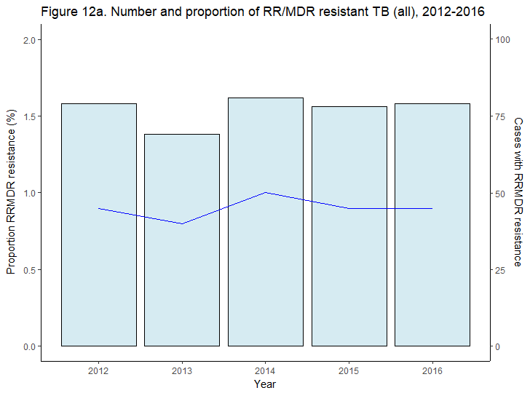
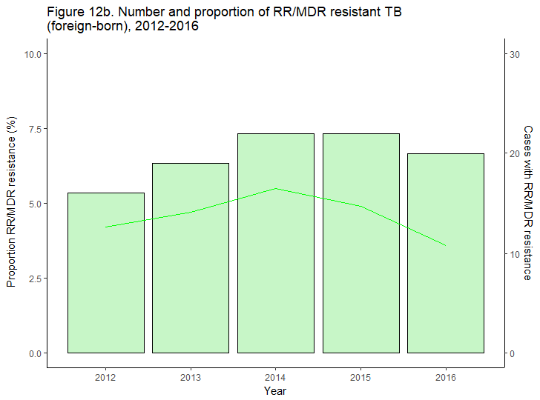
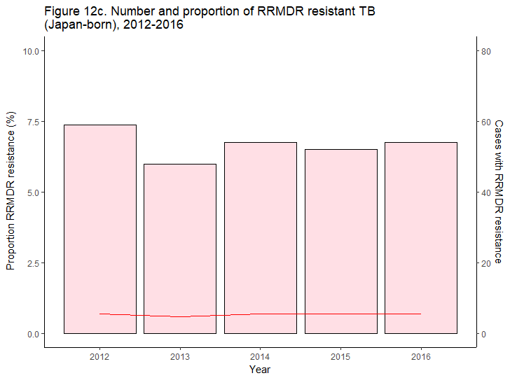

Slide 18
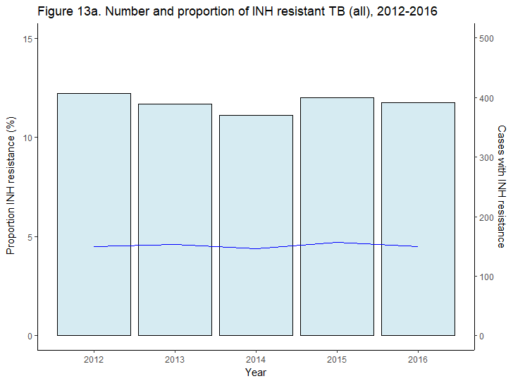
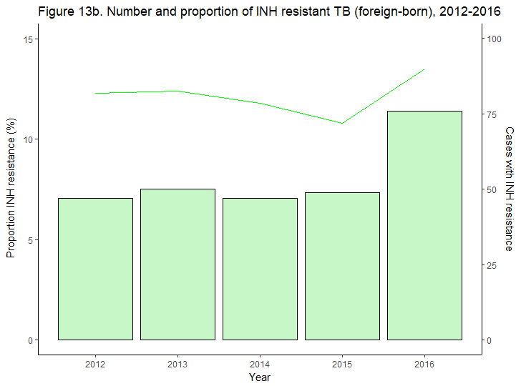
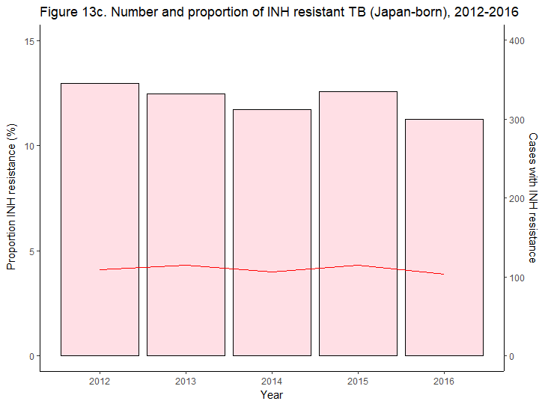

Slide 19
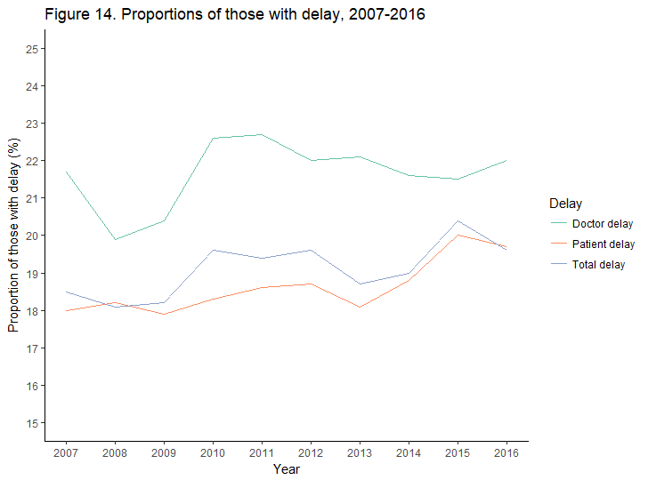

Slide 20
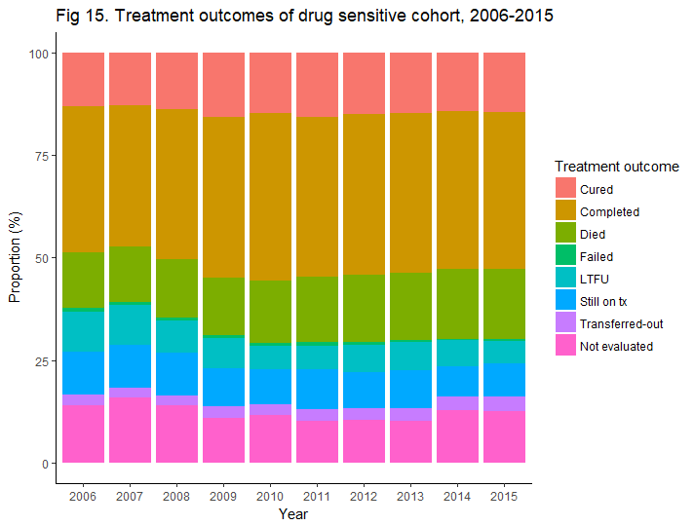

Slide 21
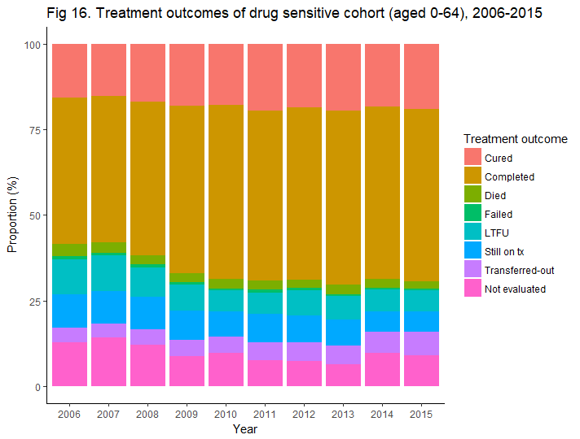

Slide 22
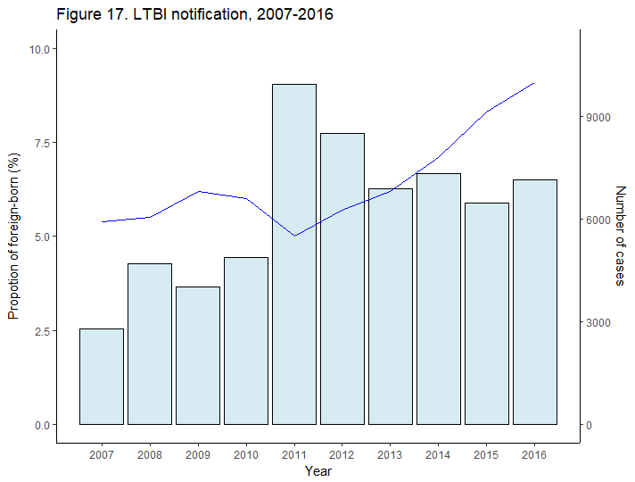
Number
Proportion

Slide 23
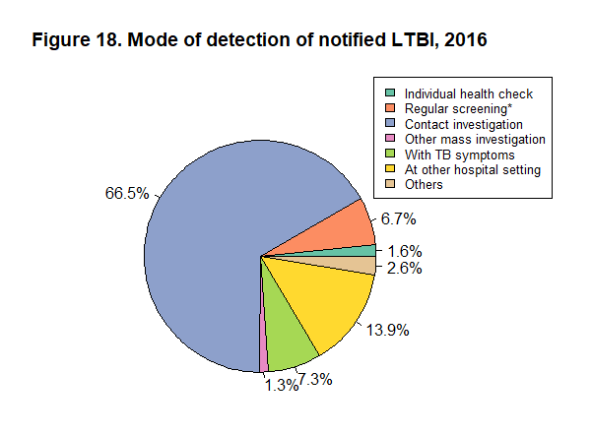

Slide 24
